Slide 1
Introducing & Integrating Cognitive Defusion Techniques in Therapy
John T. Blackledge, Ph. D.
Morehead State University
Kentucky

Slide 2
How many of you have at least some difficulty introducing defusion techniques into therapy in a way that’s seamless and not ‘overly odd’?
How many of you have at least some difficulty describing the rationale behind why you are using defusion techniques?

Slide 3
Cognitive Defusion
Purpose: See thoughts as what they are, not as what they say they are.
Method: Change the way the client experiences language/her own thoughts to disrupt language’s ability to change experience in problematic ways.
Why use?: When thoughts are functioning as barriers to effective movement toward personally meaningful values and goals:
To facilitate acceptance
To help client ‘unhook’ from unhelpful verbal rules

Slide 4
Defusion: Rationale
Defusion strategies ‘break the rules’ of language as usual to:
Disrupt its ability to change your experience
Help undercut reliance on language as the final arbiter of “Truth”.

Slide 5
What are the rules of Language as Usual?
Think of all the conditions virtually always present when language is being spoken with meaning and listened to with understanding:
Parameters exist around how sentences are structured and how words are used.
Certain words refer to certain things.
Certain minimal grammatical units must be used.

Slide 6
What are the rules of Language as Usual?
Parameters exist around how quickly words can be spoken & how frequently a word can be repeated.
Tone of voice/style of speech must reasonably match content in order for words to function as expected.

Slide 7
What are the rules of Language as Usual?
Parameters exist around what is attended to when thinking or speaking:
You attend to the content of what’s being thought or spoken about rather than the process of thinking, hearing, or speaking
Once you focus on the process of thinking or speaking, you lose the flow—you begin to focus on the fact that words or thoughts are being formed, rather than on the content of what is being formed.

Slide 8
Defusion Techniques
“The Mind”: Treat “the mind” as an external event; almost as a separate person.
Mental appreciation: Thank your mind; show aesthetic appreciation for its products.
“I’m having the thought that …”: Might include category labels in descriptions/evaluations of private events.

Slide 9
Defusion Techniques
Word repetition (e.g., ‘milk’ exercise)
Speaking very slowly
Even disrupting cadence of speech
Description vs. evaluation
Singing thought/speaking thought in odd voice

Slide 10
Defusion Techniques (or are they Self as Context?!)
Just noticing: Use the language of observation (e.g., noticing) when talking about thoughts.
“Buying” thoughts: Use active language to distinguish thoughts and beliefs.
Carry your keys: Assign difficult thoughts and experiences to the clients keys. Ask the client to think the thought as a thought each time the keys are handled, and then carry them from there

Slide 11
Defusion Techniques (or are they Self as context?!)
Writing thoughts/emotions on paper
Put them out there: Sit next to the client and put each thought and experience out in front of you both as an object.
Open mindfulness: Watching thoughts as external objects.
Focused mindfulness: Direct attention to nonliteral dimensions of experience.

Slide 12
Building a Context of Defusion
Often not a matter of ‘targeting a particular thought for defusion’.
Repeatedly creating a context in therapy where thoughts are viewed from a different perspective in different ways
Seeding in ‘mind’ and ‘thought’ talk regularly, session by session
Catching times when client is fused with unhelpful/distressing thoughts, and using one of many defusion techniques

Slide 13
Defusion: Risks
Invalidating the client
Light use (like what we’ll practice in a minute) doesn’t tend to do this.
Make sure the client knows you get it and you care before moving into heavier use/more ‘invasive’ techniques
Freaking out the client
Setting up the general notion that language is fraudulent can be awkward
The first two techniques we practice will hopefully help with this
If done clumsily, can come off as ‘weird’ (in a non-therapeutic way)

Slide 14
Defusion Exercise 1
[Precede with Cognitive Defusion—Beginning Defusion—5:50->]
Look for examples of therapist using “mind” and “thought” talk.

Slide 15
Defusion Exercise 1
Break into pairs
Roleplay therapist and client.
Therapist makes consistent use of simple “thought”/”mind” defusion statements like……..”You’re having a lot of thoughts about…..”, “What other thoughts are showing up?”, “What else is your mind saying about…..?”, “you’re having the thought that……”.
Be mindful of infusing sufficient empathy into the interaction.
We’ll roleplay for 5 minutes, then break and discuss as pairs, then as a group. Then, you’ll switch roles and repeat.

Slide 16
Using the Client’s Disclosures as an ‘in’ for using defusion
Example
Prompting the client to recall a time when he/she believed something and later found out it wasn’t true:
“Can you remember a time when you were anxious or afraid, and had some pretty convincing thoughts about bad things that were going to happen to you….and then those thoughts turned out not to be true?”
“Yeah…..Minds are good at throwing thoughts like that at us. So good that sometimes those thoughts fly under the radar and we never suspect we’ve been taken for a ride. I wonder……do you think it’s possible some of the thoughts you’re having now could be like that?”

Slide 17
Defusion Exercise 2
Demonstrate Description-Evaluation technique—roleplay with volunteer “anxious client”.
Break into pairs and practice technique (10 minutes)—discuss as pair, discuss as group, switch roles and repeat.

Slide 18
Ask client to provide examples of descriptions, then evaluations, of an object. Write them down & label them.
Ask client if the evaluations seem as ‘solid’, as ‘etched in stone’ as the descriptions. Ask them if the evaluations feel ‘fishy’?
Go through the same procedure with an emotion the client is feeling now.
Acknowledge that it’s hard to see the distinction when the emotion is intense. “But when you step back from it now……are those evaluations as solid (etc.) as these descriptions?”

Slide 19
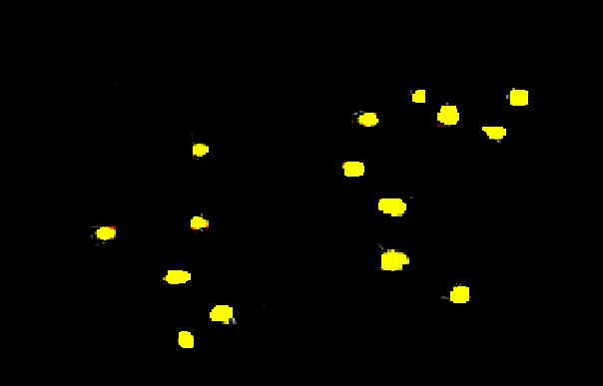

Slide 20
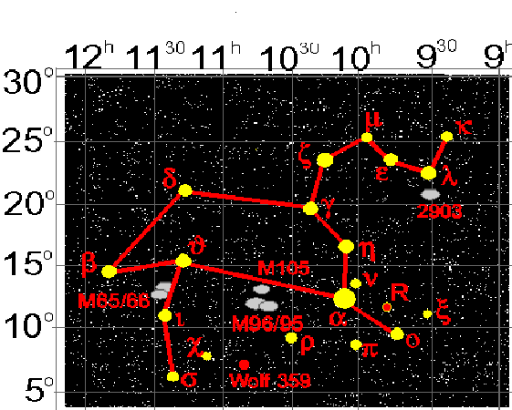

Slide 22
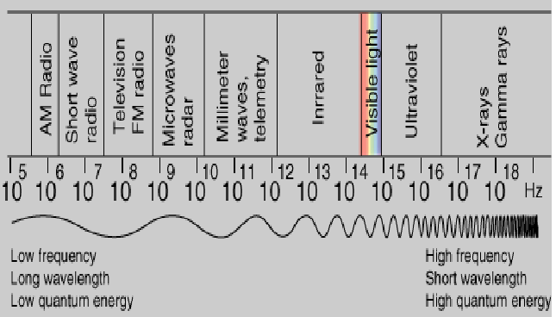

Slide 23
Defusion Exercise 3
ACT in Action—Mindfulness, self, etc.—1:07:30
Slowing down…..changing cadence of speech
Pair up
Client discusses emotionally-charged issue (e.g., recounts distressing event that links back to central focus in therapy) in a somewhat rapid manner.
Therapist jumps in as above.
10 minutes, discuss as pair, then discuss as group.

Slide 24
Defusion Exercise 4
Spotting client fusion/defusion:
Cognitive Defusion-Additional Defusion Techniques—1:10:38-1:16:00
Get into small groups
Stop disc when client fused/not fused with difficult thoughts
Discuss verbal/nonverbal signs of each
Each member of group generates a different defusion technique to address that thought.
Discuss as small group after each person’s turn?

Slide 25
Defusion Exercise 5
Learning ACT—Cognitive Defusion—17:50-
Get into small groups
Stop disc when client fused/not fused with difficult thoughts
Discuss verbal/nonverbal signs of each
Each member of group generates a different defusion technique to address that thought.
Discuss as small group after each person’s turn?

